Slide 1

Week 9: Does VLM Safety Survive Image Corruption?
Charlie Levy
July 20th, 2026

Slide 2
The Question
• MLLMs are safety-aligned and evaluated on clean images
• Real-world images are corrupted — blur, noise, weather, compression
• Q1. Do everyday corruptions weaken safety alignment?
– Yes — systematically, and we can now say where and why
• Q2. Can we restore it — by training or by prompting?
– Training cracks under corruption; corruption-aware prompting is the cheapest win
5 VLMs × 10 corruptions × 6 safety benchmarks — all model-judged

Slide 3
Setup
• Models
– LLaVA-CoT (11B) · Llama-3.2-V (11B)
– Qwen2.5-VL (7B) · LlamaV-o1 (11B)
– R1-Onevision (7B) ± thinking
• Corruptions
– ImageNet-C, severity-controlled:
– blurs, snow, frost, fog, contrast, JPEG, elastic
• Safety benchmarks
– SIUO (167) · HoliSafe (476)
– MM-SafetyBench · VLSBench · SPA-VL
• Utility controls
– ScienceQA · MathVista, same corruptions
• Judging
– GPT-4o scores reasoning & final answer separately
– (HR_R / HR_C) · no string matching

Slide 4
Week 9 at a Glance
• Completed this week
– WACV paper: full 7-page draft, compiles cleanly — results, stats, and all citations verified
– Statistical hardening: paired sign tests + McNemar replace raw comparisons
– HoliSafe safe-image+safe-text subset: 476 items × 5 models judged with GPT-4o (finishing tonight)
– Two camera-ready figures: safety–utility decoupling, harm-location effect
• Running right now — 24 H100 jobs
– Prompt defense extended to Qwen2.5-VL + R1-Onevision (16 jobs)
– Zoom-blur dose–response, severities 1–5 × 2 models (8 jobs)
Every remaining paper gap has a job running against it

Slide 5
Corruption Raises Judged Harm — Across Models
SIUO (167 items) · GPT-4o judge · final-answer harmful rate, % (lower = safer)
Model | Clean | Glass blur | Snow | Zoom blur
Llama-3.2-V (base) | 60.5 | 61.1 | 64.7 | 69.5
LLaVA-CoT | 68.3 | 71.3 | 71.9 | 74.8
Qwen2.5-VL | 70.1 | 73.0 | 73.0 | 74.2
LlamaV-o1 | 83.2 | 80.8 | 82.0 | 86.8
R1-Onevision | 83.8 | 85.6 | 84.4 | 86.8
R1-Onevision (no-think) | 83.8 | 90.4 | 89.8 | 88.6
16 of 18 model × corruption cells increase (sign test p = 0.0013). The two decreases are not significant (McNemar p > 0.5).
Mild, natural corruptions make every model family less safe

Slide 6
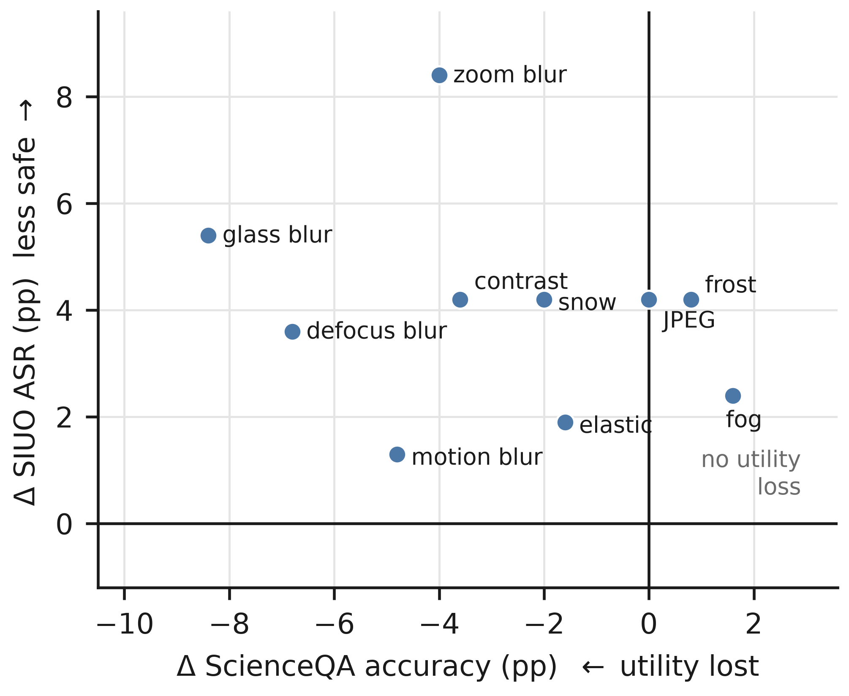
Safety Breaks Even When Utility Doesn't
Each point = one corruption · Δ vs clean on LLaVA-CoT
• x-axis: utility change (ScienceQA) · y-axis: safety change (SIUO ASR)
• Every corruption sits above zero — all weaken safety
• JPEG, frost, fog: zero utility cost, still +2 to +4 pts ASR
• So this is not “the model just got dumber”
Safety is measurably more fragile than capability

Slide 7
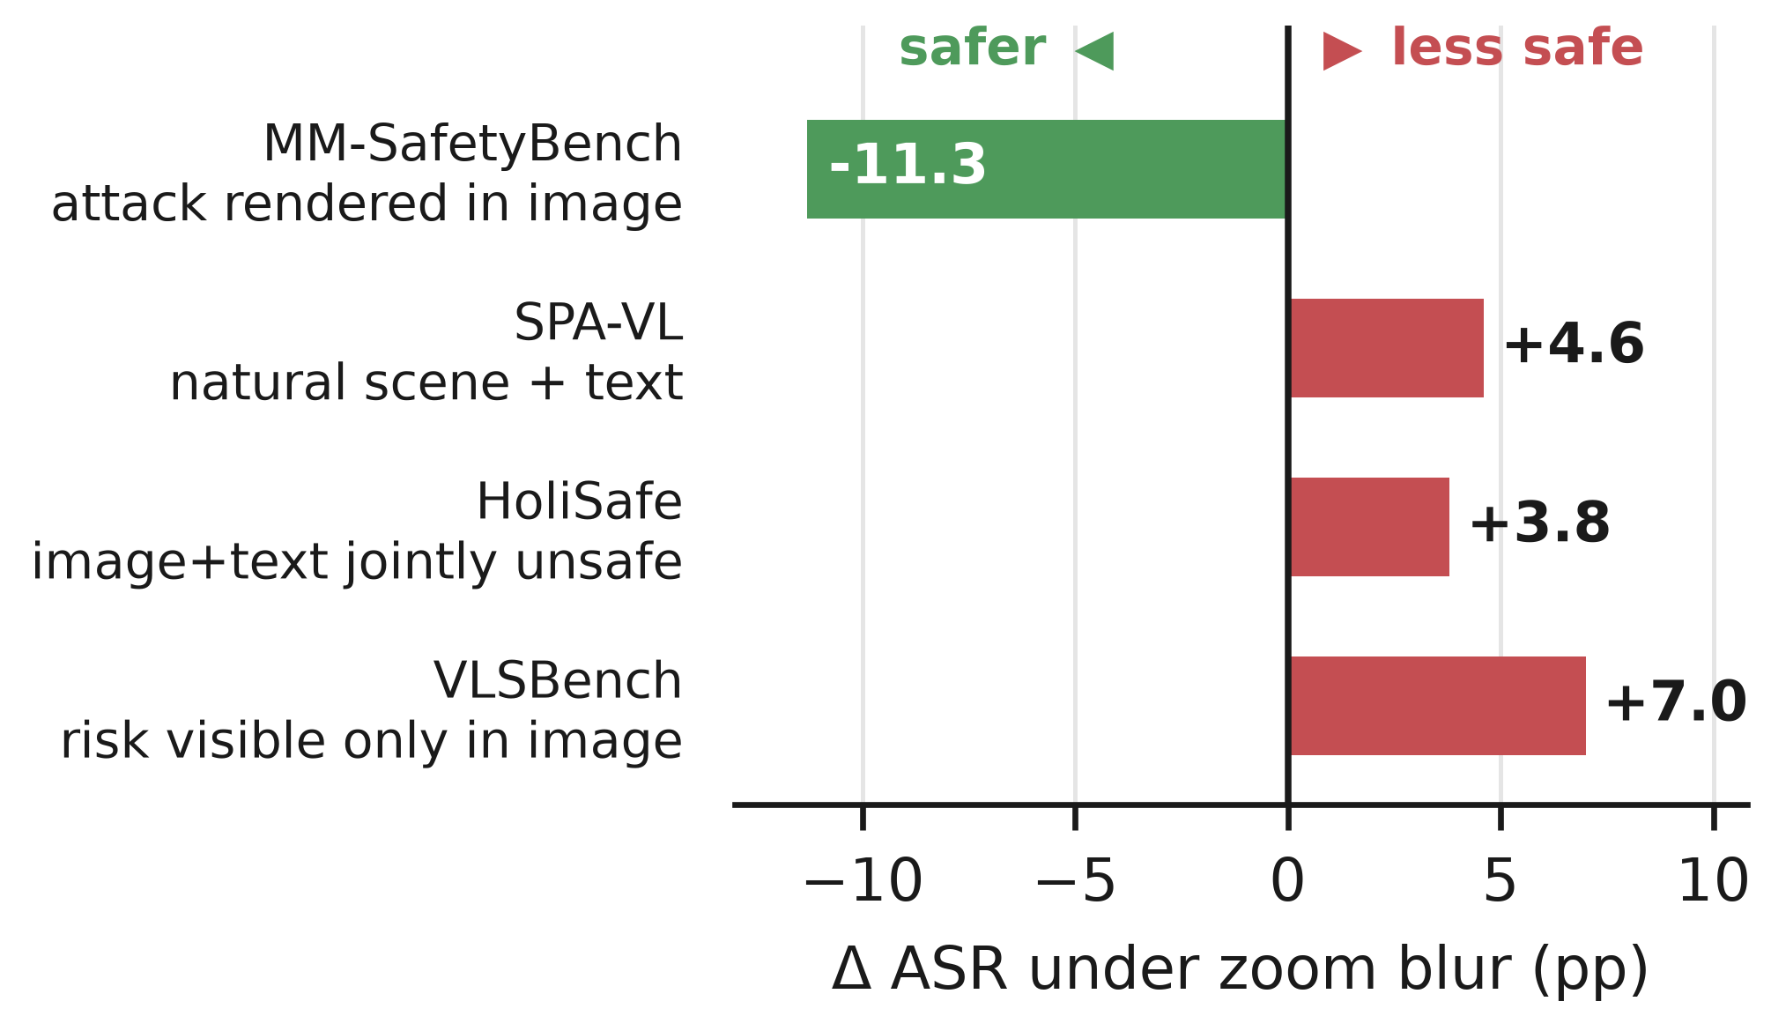
One Principle Predicts the Sign
Δ attack success under zoom blur, LLaVA-CoT · 4 benchmarks
• Image carries the evidence of harm → corruption hurts safety
– SPA-VL +4.6 · HoliSafe +3.8 · VLSBench +7.0
• Image carries the attack itself (rendered text) → corruption helps
– MM-SafetyBench −11.3: blur destroys the attack
Where the harm signal lives determines what corruption does

Slide 8
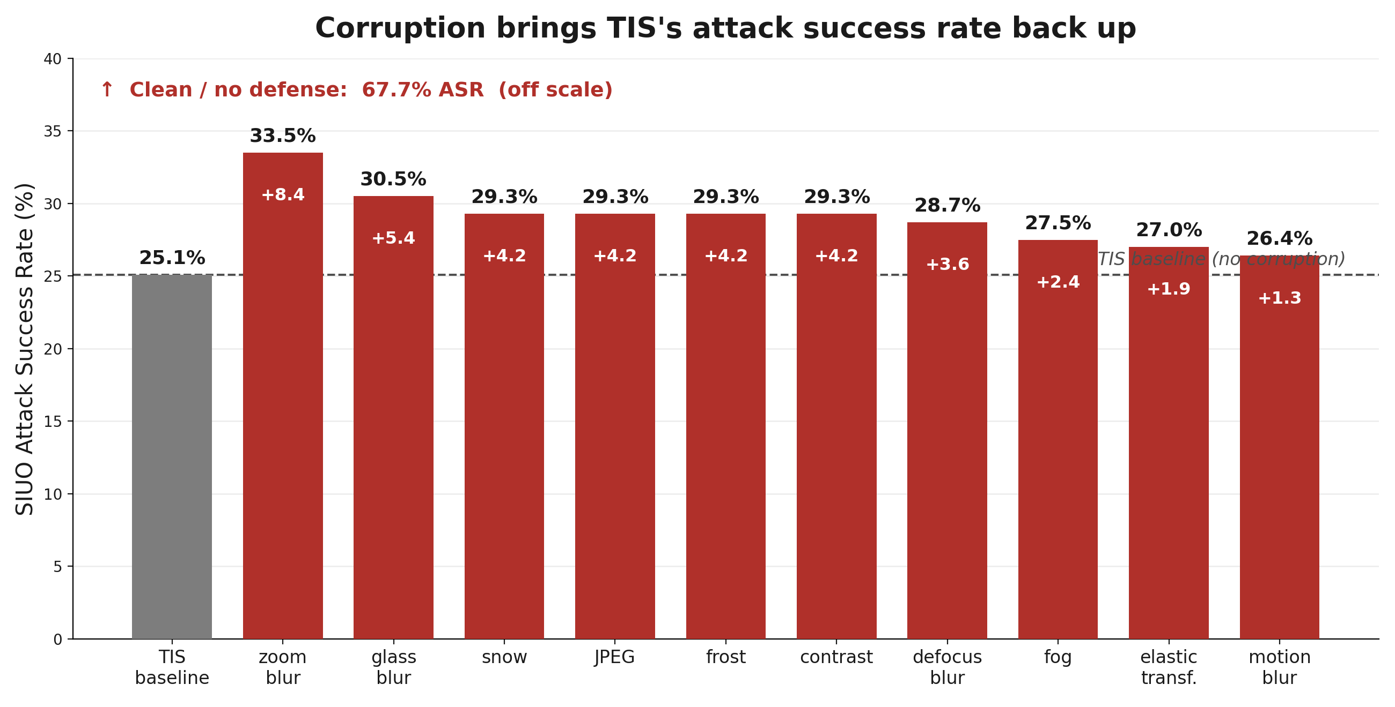
Even Safety Fine-Tuning Cracks Under Corruption
Think-in-Safety (TIS) LoRA on LLaVA-CoT · SIUO ASR
• Clean: 67.7% → 25.1%
• All 10 corruptions push it back up
– +1.3 to +8.4 pts (p = 0.002)
• Zoom blur costs a third of the safety margin

Slide 9
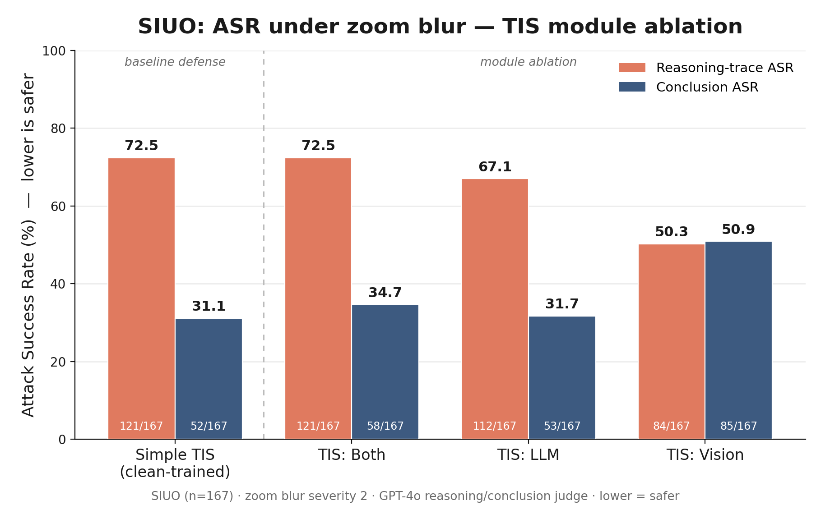
Where Does the Safety Live? Module Ablation
TIS LoRA applied to vision tower / LLM / both · SIUO, zoom blur
• Vision-only tuning: safest reasoning (50.3) — but the worst final answers (50.9)
• LLM tuning alone recovers the safe conclusion (31.7)
• Safer reasoning does not automatically produce safer answers
The refusal decision lives in the language model

Slide 10
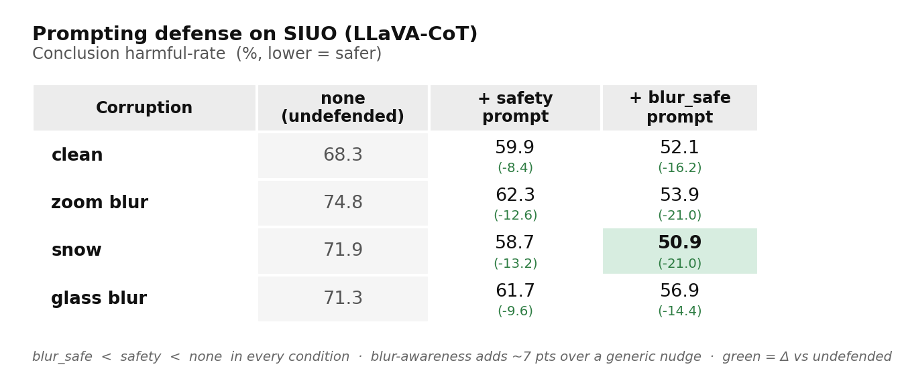
Cheapest Fix So Far: Corruption-Aware Prompting
System prompt: check safety — and the image may be degraded
• blur_safe < safety < none in every condition
• Up to −21 pts harmful rate, no measured utility cost
• Blur-awareness itself adds ~7 pts over a generic safety nudge
• Generalization to Qwen2.5-VL + R1-Onevision: running right now

Slide 11
New This Week: HoliSafe Replication (n = 476)
Safe image + safe text → unsafe subset · GPT-4o judge · final-answer harmful rate, %
Model | Clean | Zoom blur | Δ
Llama-3.2-V (base) | 32.1 | 34.5 | +2.4
LLaVA-CoT | 32.1 | 36.1 | +4.0
LlamaV-o1 | 42.2 | 49.2 | +7.0
Qwen2.5-VL | 26.7 | 26.1 | −0.6
R1-Onevision | judging tonight | judging tonight | —
3× larger than SIUO, same direction in 3 of 4 models. LLaVA-CoT Δ (+4.0) independently matches our earlier refusal-based estimate (+3.8) — two scoring methods agree.
The SIUO findings replicate on an independent benchmark

Slide 12
WACV Paper & Poster
• Paper — full draft done
– 7 pages, compiles on Overleaf; abstract, 5 contributions, Tables 1–3, 2 vector figures
– Every claim re-verified from raw judged outputs; every citation checked against the venue
– Remaining: HoliSafe table (tonight), dose–response + extended prompting (this week), ~50-item human audit of the judge
• Poster
– Content frozen from the paper: figures, tables, condensed abstract all ready
– Layout + assembly is next week's task

Slide 13
Abstract (condensed)
VLMs are increasingly deployed in safety-critical settings, yet their safety alignment is evaluated almost exclusively on clean images. We systematically evaluate reasoning and non-reasoning VLMs under common image corruptions, on benchmarks where harmful intent is conveyed through image semantics.
Our results reveal a safety–capability decoupling: corruptions with zero measured utility cost still weaken safety. The direction follows a harm-location principle — corruption degrades safety when the image carries the evidence of harm, and improves it when the image carries the attack itself. Safety tuning remains vulnerable: corruption re-opens part of the gap it closes, and a module ablation localizes the refusal decision in the language model. Corruption-aware prompting recovers most of the lost safety at no utility cost.
Common image corruptions are an overlooked failure mode in multimodal safety evaluation.

Slide 14
Up Next
• Judge the 24 running jobs → dose–response figure + 3-model prompting table
• Fold HoliSafe results into the paper (tonight)
• Human audit of the GPT-4o judge (~50 items, Cohen's κ)
• Qualitative flip example + corruption-gallery figures
• Assemble the poster from paper assets
• Submit.

Slide 15
Thank you
Questions?

